Slide 1
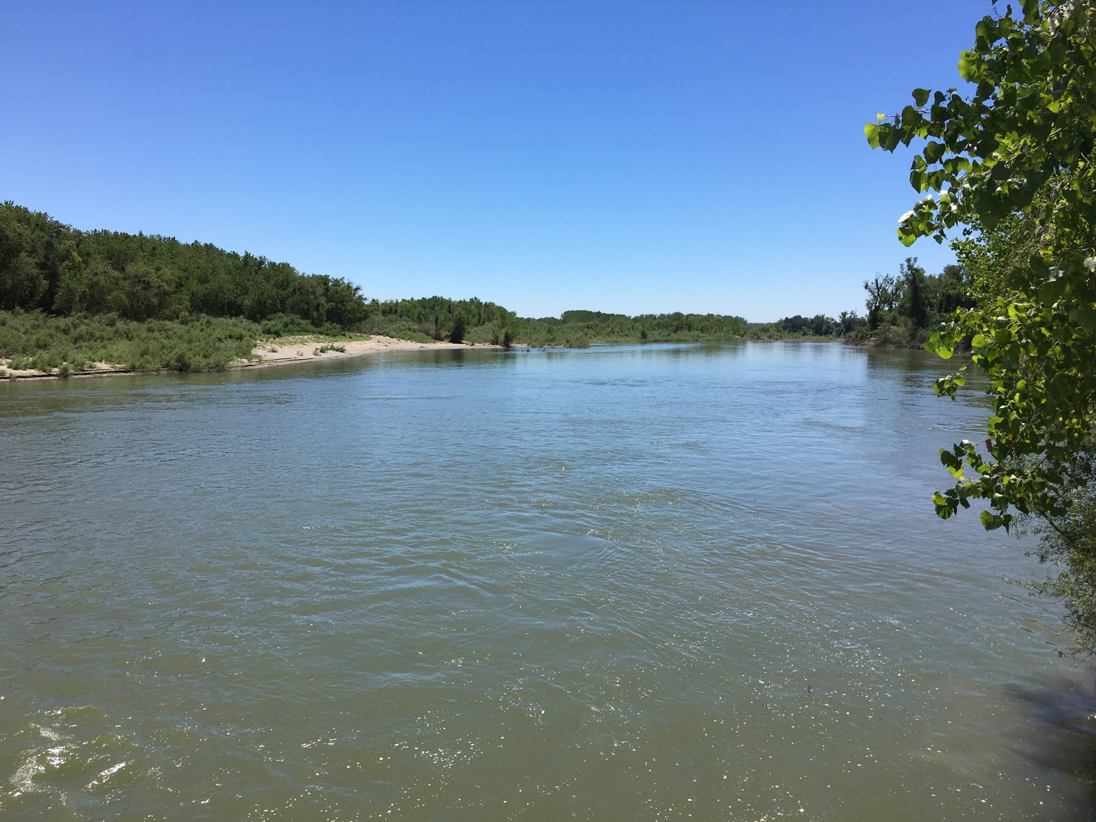
Sites Project: Topic Area Update Meeting
California Department of Fish and Wildlife
March 21, 2019

Slide 2
What is the Sites Project?
New large reservoir, regulating forebays, pipeline and Sacramento River diversion
Fourteen miles long, 1.82 MAF storage
Two 300’+ earthen dams, 9 saddle dams
Two forebay regulating reservoirs connecting to existing irrigation canals
14 miles of twin barrel, 12’ diameter pipelines and two pump/generation
New 2,000 cfs diversion/pumping facility
Sustainable Surface Water Infrastructure Improvement
Benefits endangered species and refuges
Increases water supply in drier years
Reduce regional floods
Increases recreation
Is more effective with Climate Change
Proposed by a local joint-powers authority. Participants throughout CA, Reclamation, State
2
Notes:
Sites is a sustainable surface water project that uses available facilities and adds storage and conveyance to:
improve conditions for chinook salmon in drier years and delta smelt in all late-summers and falls
Increases deliveries to wildlife refuges in dry years
Eliminates floods that closed I-5
Increases water supplies for families, farms and business in drier years
Is more effective as climate changes occurs

Slide 3
Regional Map

Slide 4
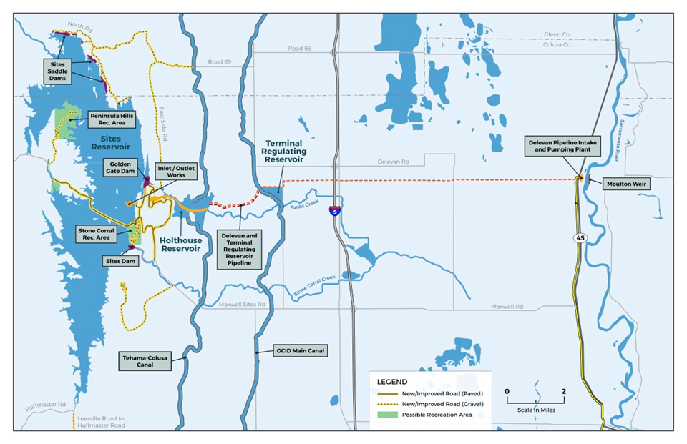
Project Facilities

Slide 5
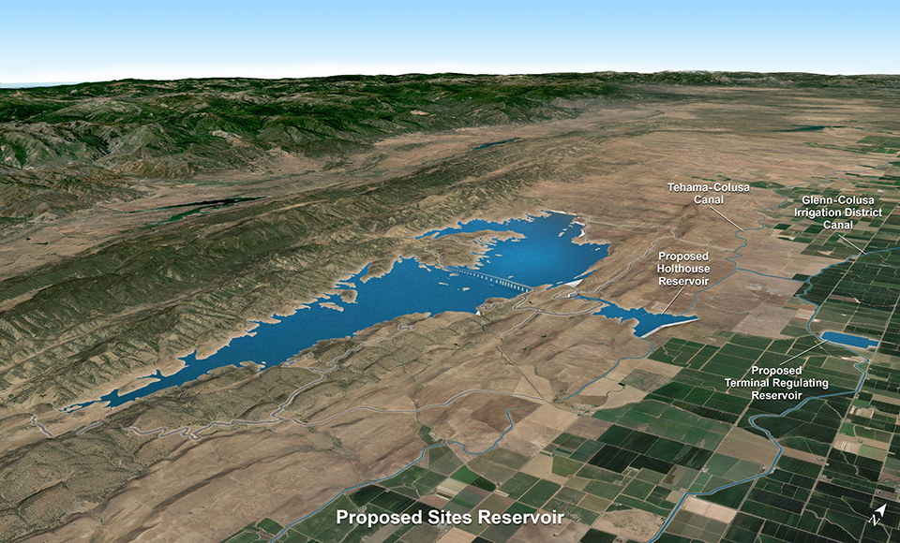
Project Objectives
Primary:
Water Supply and Water Supply Reliability
Anadromous Fish Net Improvements
Operational Flexibility
Pelagic Estuarine Fish Net Improvements
Wildlife Refuge Supply
Secondary:
Hydropower
Recreation
Flood Damage Reduction

Slide 6
Preliminary Design/Permitting Schedule
Jan 2018
Mar 2019
Jan 2020
Jan 2021
Jan 2022
Jan 2030
Time Now
Prop 1 Ca Water Commission
Application Review
Encumber Prop 1
Funds
Early Funding
Federal WIIN Act
Final Feasibility Report
Post Authorization Report
Federal Deemed Feasible
Federal Authorizations (WIIN Act)
Planning & permitting
Draft EIR/S
EIR/S
Final
Supplement
ROD, NOD, Permits, & Agreements
Permit Planning & Applications
Permits & Water Right
Engineering & Rights of Way
Preliminary Design & Geotech
Final Design
Rights of Way
Acquisition
Construction
Construction
operations
Early Ops
2019 Jan 01, Subject to Change
6
Notes:
Pub.L. 114-322: 4007(i): Deemed feasible before Jan 1, 2021.
4013 Be in construction before 2021 Dec 16

Slide 7
Previous Analyses
Draft ER/EIS
CalSim II (2010 DCR)
DSM2, Upstream Water Temperature
SALMOD, IOS
Delivery assumptions vary for alternatives
CWC WSIP Applications and Appeal
CalSim II (2015) provided by DWR
Unique Climate Change Assumptions
DSM2, Upstream Water Temperature
OBAN, SALMOD
Delivery assumptions based on Alternative D
7
Notes:
Sites is a sustainable surface water project that uses available facilities and adds storage and conveyance to:
improve conditions for chinook salmon in drier years and delta smelt in all late-summers and falls
Increases deliveries to wildlife refuges in dry years
Eliminates floods that closed I-5
Increases water supplies for families, farms and business in drier years
Is more effective as climate changes occurs

Slide 8
Example Analyses Since DEIR and WSIP
Sacramento Riverine Habitat Estimation
Based on flood inundation – habitat mapping. Red Bluff to Knights Landing
Nature Conservancy Habitat types
HEC-RAS and GIS computation
Hydraulic-limited river diversion limitations
Stairstep limits to diversions based on SacRiver stage - flow
Considers screen-pump limits at each location
Reduces lower-flow diversions
CalSim II merged model adding optional analysis of:
CA Water Fix with variable diversion rates
Freemont Weir notch
Various climate change assumptions

Slide 9
Daily Sacramento River Operations Modeling
Provide information and help develop further understanding of the interaction of the proposed Sites Reservoir Project over a wide range of potential flow conditions in the Sacramento River.
Assess potential ecosystem benefits of coordinated Sites operations
Simulates daily flow conditions in the Sacramento River from Shasta Lake to Knights Landing
Uses available historical gage records and reservoir operations records for period 1964 – 2018

Slide 10
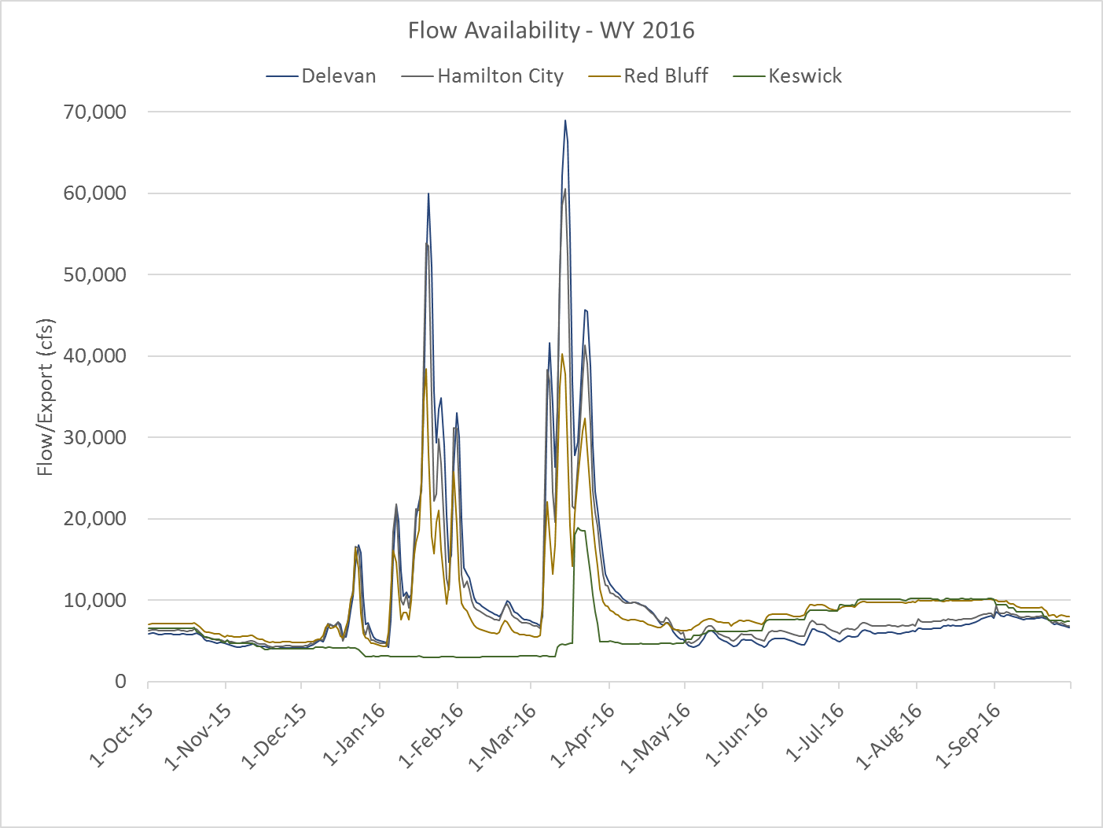
Flow Hydrograph Example

Slide 11
Planned Analysis Tools
CalSim II – merged model with existing
USRDOM – expanded calibration and analysis to May 2018
Sacramento River HEC5Q model
American River HEC5Q Model
USBR Monthly Temperature Model
USBR early life stage mortality models
SALMOD
OBAN
IOS
DPM
DSM2 HYDRO, DSM2 QUAL, DSM2 PTM
Power models including LTGen, SWP Power and NODOS Power model
Economics Models including LCPSIM/CWEST, SWAP, LCRBQM and OMWEM
HEC-RAS for water surface change – habitat variation
CE-QUAL – W2 for Reservoir Water Quality

Slide 12
Fish Screen Study Plan
Prepare a draft plan of study for evaluation of diversions to Sites Reservoir and potential impacts to fish survival associated with intake facility operations at the Red Bluff Pumping Plant, Hamilton City, and the proposed Delevan Intake.
Perform literature review
Identify information to establish biological baselines
Identify information to support permitting and development of performance criteria
Identify information to inform facility design
Identify pre- and post-construction monitoring and evaluation (M&E) requirements
Identify any long-term M&E requirements

Slide 13
ESA Schedule:
Presidential Memo (10/19/2018)
Encourages Commerce and Interior to work together
Streamline regulatory process
In accordance with applicable law
Sites Project identified as major water project
Establishes schedule
Joint biological assessment due to agencies in September 2019
Biological Opinions by February 2020

Slide 14
State Listed Terrestrial Species
Species | Federal Status | State Status
Foothill yellow-legged frog | No listing | Candidate, Threatened
Giant garter snake | Threatened | Threatened
Bald eagle | Delisted | Endangered
Swainson’s hawk | No listing | Threatened
Bank swallow | No listing | Threatened
Western yellow-billed cuckoo | Threatened | Endangered
Tricolored blackbird | No listing | Threatened
Greater Sandhill Crane | No listing | Threatened, Fully Protected
Palmate-bracted bird’s beak | Endangered | Endangered

Slide 15
Mapping Approach
ICF is mapping land cover through aerial photo interpretation using
Google Earth
National Agricultural Imagery Program (NAIP) imagery
Topographic data obtained through LIDAR

Slide 16
Terrestrial Species Models
Foothill yellow-legged frog | Perennial and intermittent streams with rocky substrates (not Sacramento River), Stone Corral Creek, Funks Creek (above reservoir), Antelope Creek
Giant garter snake | (Valley floor) AQUATIC - agricultural ditches, canals, freshwater emergent wetland, managed wetland, rice . UPLAND - areas within 200 feet of aquatic habitat that include annual grassland, other ag, disturbed, barren.
Western yellow-billed cuckoo | Riparian patches at least 25 acres in size
Swainson's hawk | NESTING - Riparian, other tree stands, isolated trees (not blue oak woodland); FORAGING - Minimum of 5-acre patches. Annual grassland, seasonal wetlands, alfalfa, hay fields, field crops, row crops, managed wetlands
Tricolored blackbird | NESTING - emergent marsh, managed wetland, riparian (blackberry thickets) FORAGING - annual grassland, seasonal wetland, grain/hay crops, field crops, rice, fallow
Bald eagle | NESTING - Riparian, FORAGING - Reservoir, river

Slide 17
WSIP Process Lessons Learned
What we thought
Sites = cold water pool management = climate resiliency = anadromous fish benefits
What we learned
Need to revisit benefits to salmon populations
Collaboration with regulatory agencies is essential
Benefit of pulse flow to Yolo Bypass for delta smelt acknowledged
Benefit to refuge water supply acknowledged

Slide 18
Approach to Biological Assessment
The Challenge:
Given flexibility created by off-stream storage for management of cold water pool and flows;
How do we build and operate the project to provide a net benefit to fishery resource?
We would like to work with CDFW, NMFS, and USFWS to develop an approach to weigh benefits and impacts of operations
And develop an operations plan that is expected to achieve a net benefit to the environment

Slide 19
Near-Field Effects Analyses
Salmonids:
Spatial distribution (horizontal/vertical: literature review, with specific info. for water surface elevations of screens, etc.)
Entrainment (size distribution)
Impingement/screen contact/passage time (literature review & Swanson et al. analyses)
Predation (literature review, incl. Vogel GCID studies)
Stranding behind overtopped screens (high flow, based on water surface elevation)
Green Sturgeon:
Review of protective velocity criteria and timing (Verhille et al. 2014)
Entrainment (size distribution)

Slide 20
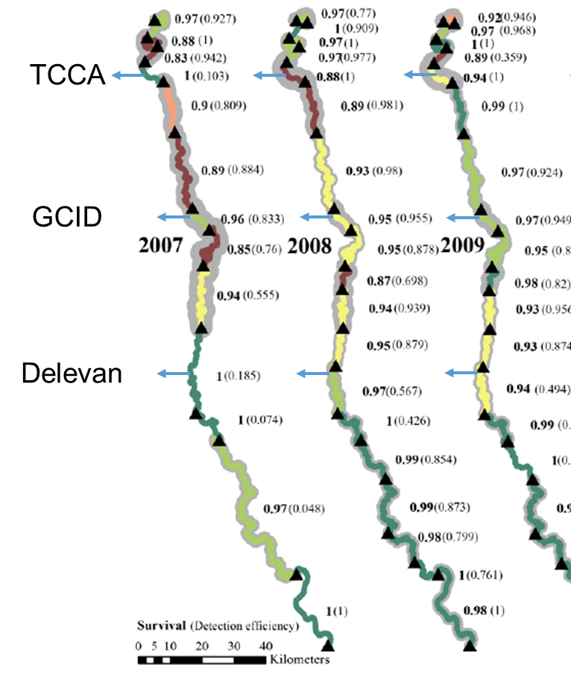
Far-Field Flow-Survival Analysis
Juvenile Chinook Salmon:
Proposing to use model from new Henderson et al. (2018) paper
Peer-reviewed (CJFAS)
Multiple reaches from above Red Bluff down to Knights Landing
Focus on Sites withdrawal period (winter/spring), daily timescale
Incorporates flow and temperature effects
Also includes other (non-operations) covariates
Results will allow adjustment of other models, e.g., OBAN

Slide 21
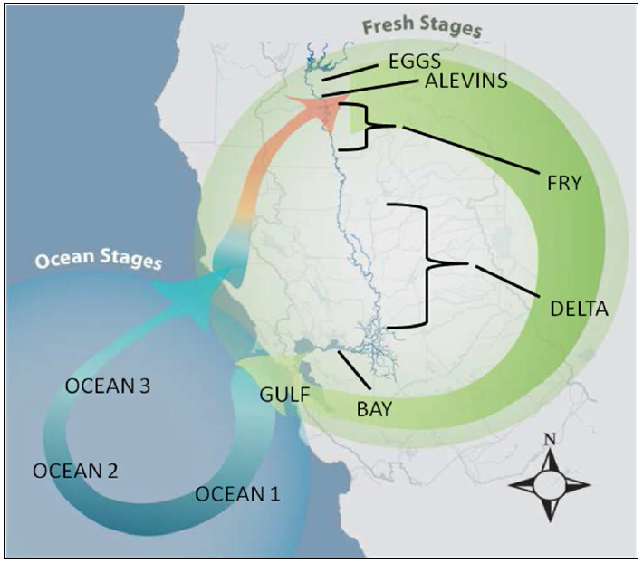
Life Cycle Modeling
OBAN:
Winter-Run Chinook Salmon
July-Sep temp. (eggs/alevins)
Aug-Nov flow (fry)
Dec-Mar Yolo flow (juveniles)
Dec-Jun exports (juveniles)
DCC (Dec-Mar) (juveniles)
Adjustment of Sac. R. migration survival per Henderson et al. results
Ocean conditions not affected by project but included in model (productivity and harvest)

Slide 22
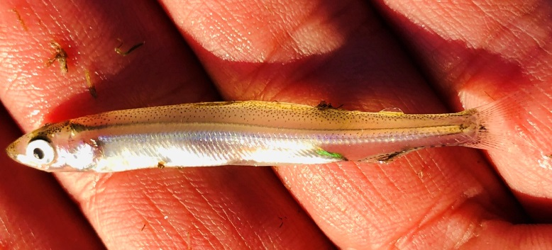
Effects to Delta Species
Delta Smelt
Fall X2 habitat (Feyrer et al. 2011)
Adult and larval entrainment (Grimaldo et al. 2009; Grimaldo et al. 2017)
Later summer/fall flows carrying food (IEP Studies)
Sediment entrainment by Project intakes
Longfin Smelt
Juvenile abundance vs winter-spring outflow (Kimmerer et al. 2009
Stock-recruit dynamics (Nobriga and Rosenfield 2016)
Adult and juvenile entrainment (Grimaldo et al. 2009)

