Slide 1
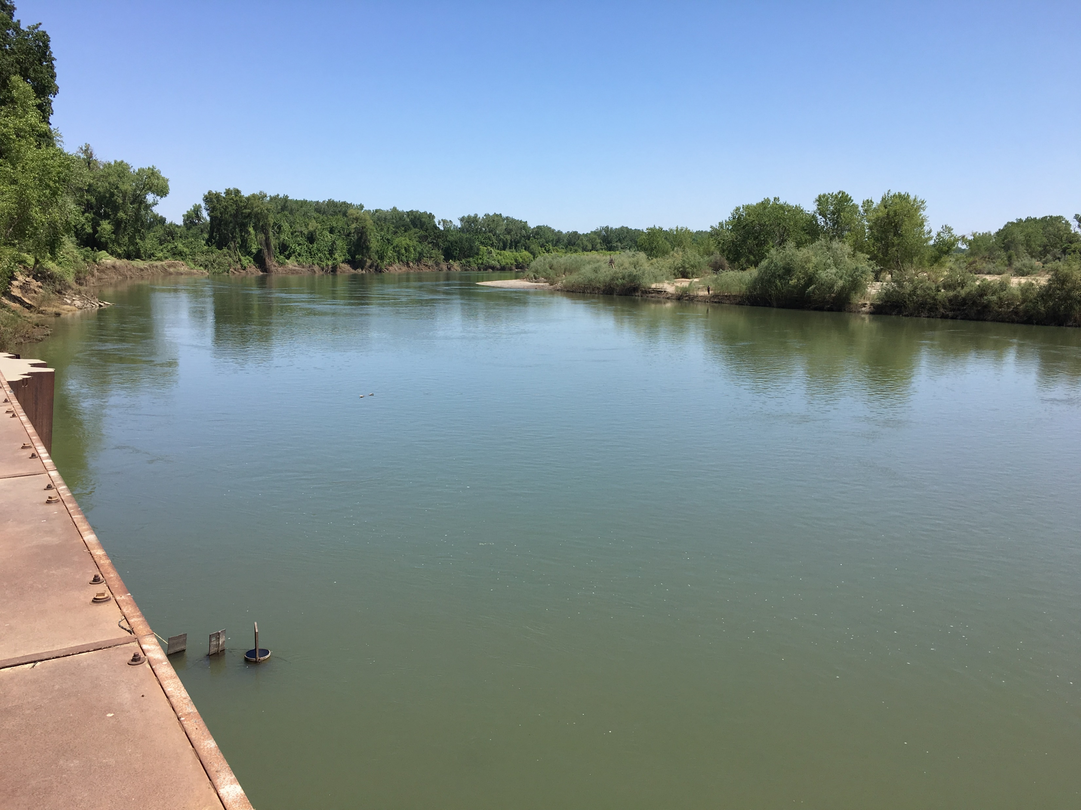
CDFW - Sites 60 day Evaluation
June 5, 2019
Sites

Slide 2
Agenda
Introductions and Purpose
Recap and Update
OBAN and Flow-Mortality Approach
USRDOM
CalSim Details
Next Steps

Slide 3
Purpose of the 60-day
Guide the Authority to increase the clarity of the Project Description and supporting analyses for an affordable project capable of providing meaningful water supply and dedicated ecosystem benefits looking toward
Final EIR/EIS
Permit applications

Slide 4
Action Items
Distribution of Henderson
Distribution of Presentation
Definition of desired analysis years
Coordination of other technical teams, contacts

Slide 5
Life-cycle and Flow Mortality Analyses

Slide 6
USRDOM and CalSim2 Details

Slide 7
Next Meeting Planning
This technical team
Week of June 10
Topics
Action Items
Other technical teams?

Slide 8
Anticipated Issues
Diversion rate and timing
Trigger values
Floodplain and Bypass habitat
Coldwater pool development and release
Flow stability supply development and release effects
Flow-mortality analysis and scientific basis
Sites Reservoir water quality and release effects
Sediment management
Delta Outflow management and effects

Slide 9
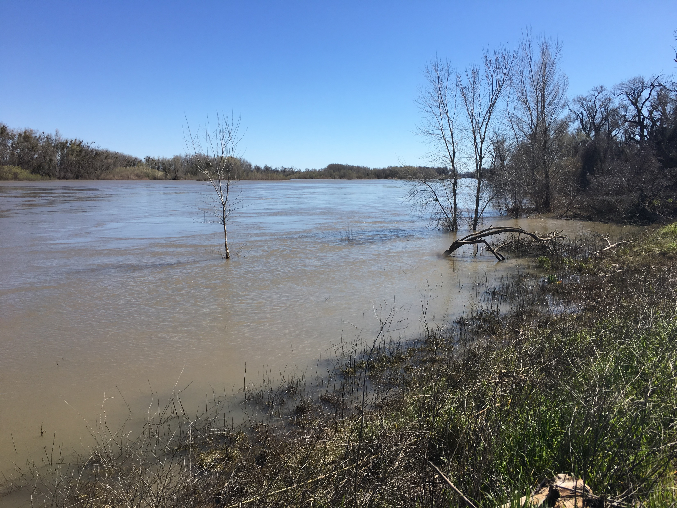
Next Steps?
Topics, Date

