Slide 1
Sites Project Joint Aquatic Workshop
Pulse Flows for Salmon: Sites Reservoir Project Diversion Criteria
May 14, 2021 Workshop

Slide 2
Agenda
Introductions and Objectives
Objectives and Approach for Today
Agency Prioritized Questions Received
Rationale Discussion
Exchanges and Upper Sacramento River Temps
Next Steps

Slide 3
Objectives and Approach
Sites review prioritized comments received
Diversion rationale
Biological and/or otherwise
Q&A session on operational components and rearing impact assessment
Exchanges and temperature of upper Sacramento River
Water quality questions will have a dedicated workshop
Notes:
John

Slide 4
General Comment Areas
Biological rationale for diversion and operation criteria
Methodology of water delivery and analysis of water sent through Yolo bypass, south-of-delta and North Bay Aqueduct
Fish presence monitoring for operations
Temperature effects to Sacramento River and Yolo Bypass due to deliveries
Shasta exchanges and biological benefits vs diversion impacts
Oroville and Folsom exchanges and impact assessment methodology
Effects of operations to Funks and Stone Corral Creeks

Slide 5
Rationale

Slide 6
Rationale – Regulatory Framework
Among all the statutory and permit requirements Environmental review and ESA compliance under the respective state and federal laws is paramount
The framework for decision making under those statutes is: a comparison of future conditions with and without the project
To make these workshops meaningful we would like to shift to focus to determination of effects and where appropriate identification of mitigation

Slide 7
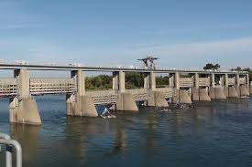
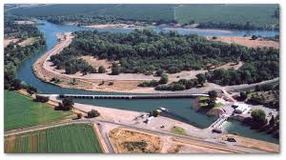
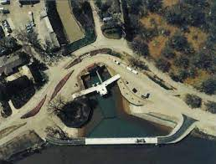
Biological Rationale – existing standards
RBDD
GCID
RD 108

Slide 8
Biological Rationale – Bend Bridge Pulse flow
Focus of April 9, 2021 workshop
• Rich body of literature on the value or flood plains, side channels, and tributary streams as rearing habitat
• Recent literature on flow survival relationship for emigrating smolts (Michel et al. 2015, Henderson et al. 2018, Notch et al. 2020 )
• Recent literature on the importance of variability in the hydrograph, particularly in drier year, in survival of emigrating smolts (Michel et al. 2021, Hassrick et al. in prep)

Slide 9
Biological Rationale - Bend Bridge Pulse flow
Challenges with existing literature
There isn’t a good metric to relate flow to survival through the rearing phase of the life cycle
The flow survival relationships presented in the literature (e.g. Michel 2015 and Henderson 2018) are based on a comparison of smolt survival in wet years and dry years.
Fish survive better in wet years, however, the application of these studies to within year operational decisions is limited
The literature on variability in the hydrograph (Michel et al. 2021 and Hassrick et al. in prep) appears more relevant to within year operations

Slide 10
Biological Rationale – Operations
Real-time monitoring will be key, but
We need input from this group
Hydrology
Fish presence
What point do we turn on the pumps?
How does the project gain access to the existing monitoring program?
Would Sites project need to augment monitoring for real-time presence absence? If so, how?

Slide 11
Biological Rationale – How to Assess Impacts to Rearing Habitat?
Literature is sparse with options
Relationship between flow and habitat is the current metric
Seems like more side channel is beneficial
We are modeling change with and without project
How does that relate to quantifiable effect?
What is the threshold where an effect would be realized?
2,900 cfs max diversion
What has been used in the past or in development?

Slide 12
Exchanges and Upper Sacramento Temperatures

Slide 13
Exchanges and Temperatures Upper Sac
Modeled exchange criteria:
Time Period: April through June
Water Year Types: Dry and Critically Dry water years
Temperature Management Tiers: 2, 3 and 4
Minimum flow requirement at Keswick:
6,000 cfs in April and May
10,000 cfs in June
Release criteria
Time Period: August through November
Notes:
April through June in Dry years
April and May in Critically Dry years
Releases are prioritized in August through October
CVP OpFlex provides additional benefits

Slide 14
Exchanges and Benefits
Frequency of exchange
8 years of 82-year planning simulation period with exchange volume greater than 50 TAF
Volume of exchange
From 50 TAF to 230 TAF
Temperature benefits
Decreases of up to 2 deg F in Sac River at Clear Creek
Early life stage temperature-based mortality
Martin: Decreases of up to 9% in a given year
Anderson: Decreases of up to 17% in a given year
Notes:
- Exchanges, in concert with CVP OpFlex and water transfers, increase flexibility Shasta cold water pool operations

Slide 15
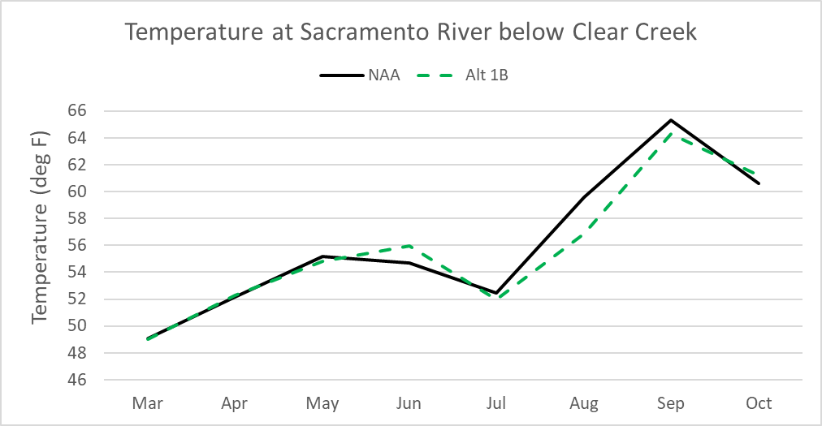
Exchanges and Temperatures
Year: 1977
Water Year Type: Critically Dry
Temperature Tier: 4
Notes:
- Temperature reduction of roughly 2.5 deg F in Aug and 1 deg F in Sep

Slide 16
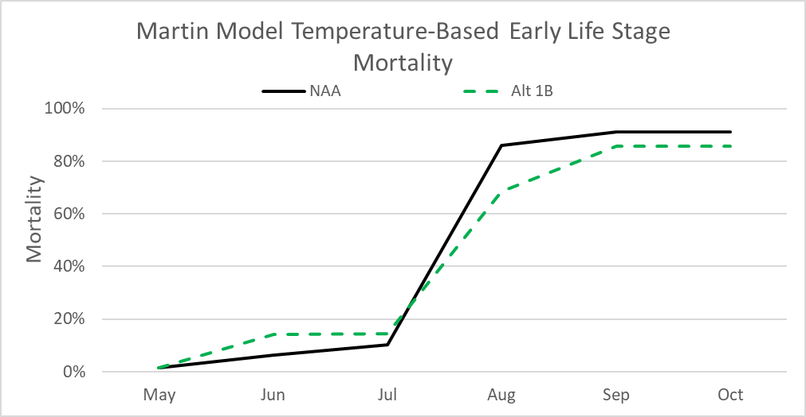
Exchanges and Temperatures
Year: 1977
Water Year Type: Critically Dry
Temperature Tier: 4
Notes:
- 5% reduction in mortality

Slide 17
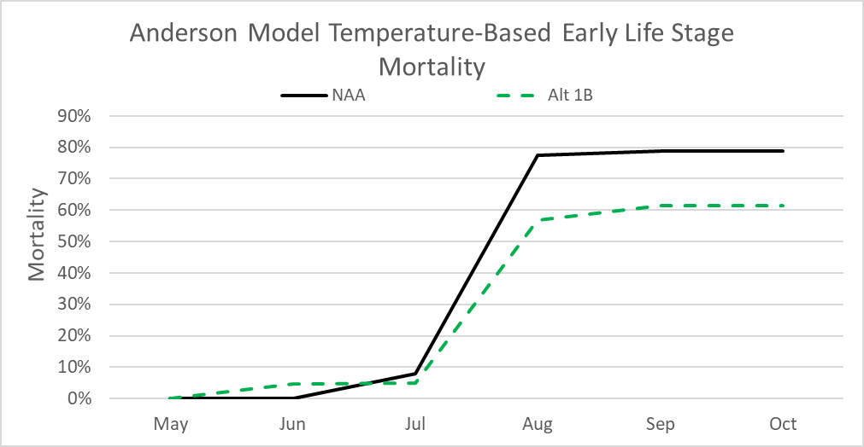
Exchanges and Temperatures
Year: 1977
Water Year Type: Critically Dry
Temperature Tier: 4
Notes:
- 17% reduction in mortality

Slide 18
Next Steps
Topics for next workshop
Change in approach for workshop?
What would be more effective?
Schedule for next meeting

Slide 20
Sites Project Diversion Criteria
Sites Diversion Criteria
Bend Bridge Pulse Protection Season | October - May
Bend Bridge Pulse Protection Initiation Criteria | 3-day average Sacramento River must exceed 8,000 cfs; 3-day average tributary flow must exceed 2,500 cfs
Bend Bridge Pulse Protection Duration | 7 days upon initiation
Bend Bridge Pulse Protection Re-setting Criteria | After completion of pulse protection period, resetting criteria must be met for another pulse protection period to commence: 3-day Sacramento River flow must go below 7,500 cfs for 7 consecutive days; 3-day moving average tributary flow must go below 2,500 cfs for 7 consecutive days
Wilkins Slough Bypass Flow | 8,000 cfs April - May; all other times, 5,000 cfs
Fremont Weir Notch Criteria | Prioritize the Fremont Weir Notch, Yolo Bypass preferred alternative, flow over weir within 10% when spill range between 600 cfs and 6,000 cfs; First 600 cfs of spill are protected within 1%
Flows into the Sutter Bypass System | None
Freeport Bypass Flow | None
Surplus Delta Outflow | 7 days of flow availability in February – March is required before diversions can be made in those months
SWP ITP Delta Outflow | 44,500 cfs April - May

Slide 21
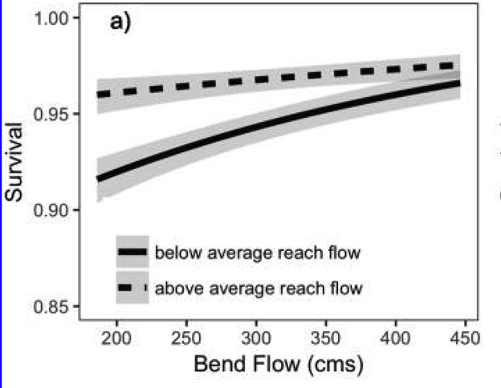
Riverscape Level – Henderson et al. (2018)
Reach x Year flow interaction
Covariate response
High flow year (above ave.)
Low flow year (below ave.)
Notes:
If flow within a reach was well above the annual average, as it would be after a precipitation event, there was relatively little (1.6% per 10 km) difference between survival in low- and high-flow years. In contrast, below average flows within a reach resulted in large (5% per 10 km) differences in survival between low- and high-flow years.

Slide 22
Factors That Affect Winter Run Survival
Notes:
Figure 6. Parameter estimates (± 95% confidence intervals) of slope coefficients (i.e., beta estimates) for each covariate in the selected model. Confidence intervals that overlap zero indicate no detectable effect.

Slide 23
Riverscape Level – Hassrick et al. (in prep)
Survival as a function of mean annual flow
Slope coefficient for intra-annual reach flow as a function of mean annual flow.
Combined mean annual flow and intra-annual reach flow on predicted survival
Shaded regions in panels A and B show 95% confidence intervals
Draft - Predecisional Working Document - For Discussion Purposes Only
Notes:
Effects of mean annual flow, interannual reach flow, and their interaction on predicted survival. Panel A shows predicted survival per 10 km per day as a function of mean annual flow with interannual reach flow and all other covariates set to mean values. Panel B illustrates the effect of the interaction between mean annual flow and interannual reach flow, showing the slope coefficient for interannual reach flow as a function of mean annual flow. Symbols in panel B show the slope for interannual reach flow for each value of mean annual flow (symbols jittered vertically slightly to reduce overlap). Panel C shows the combined effect of mean annual flow and interannual reach flow on predicted survival per 10 km per day. Shaded regions in panels A and B show 95% confidence intervals.

Slide 24
Nonlinear Flow-Survival - Michel et al. (2021)
Notes:
Jim: Figure 3. Survival as a function of flow. Survival estimates (circles) with 95% confidence intervals (bars) for groups at 5% quantile bins of experienced flow, plotted at the median value of bins (in cfs) on the x-axis. Flow experienced per fish is indicated by vertical tick marks on x-axis.

Slide 25
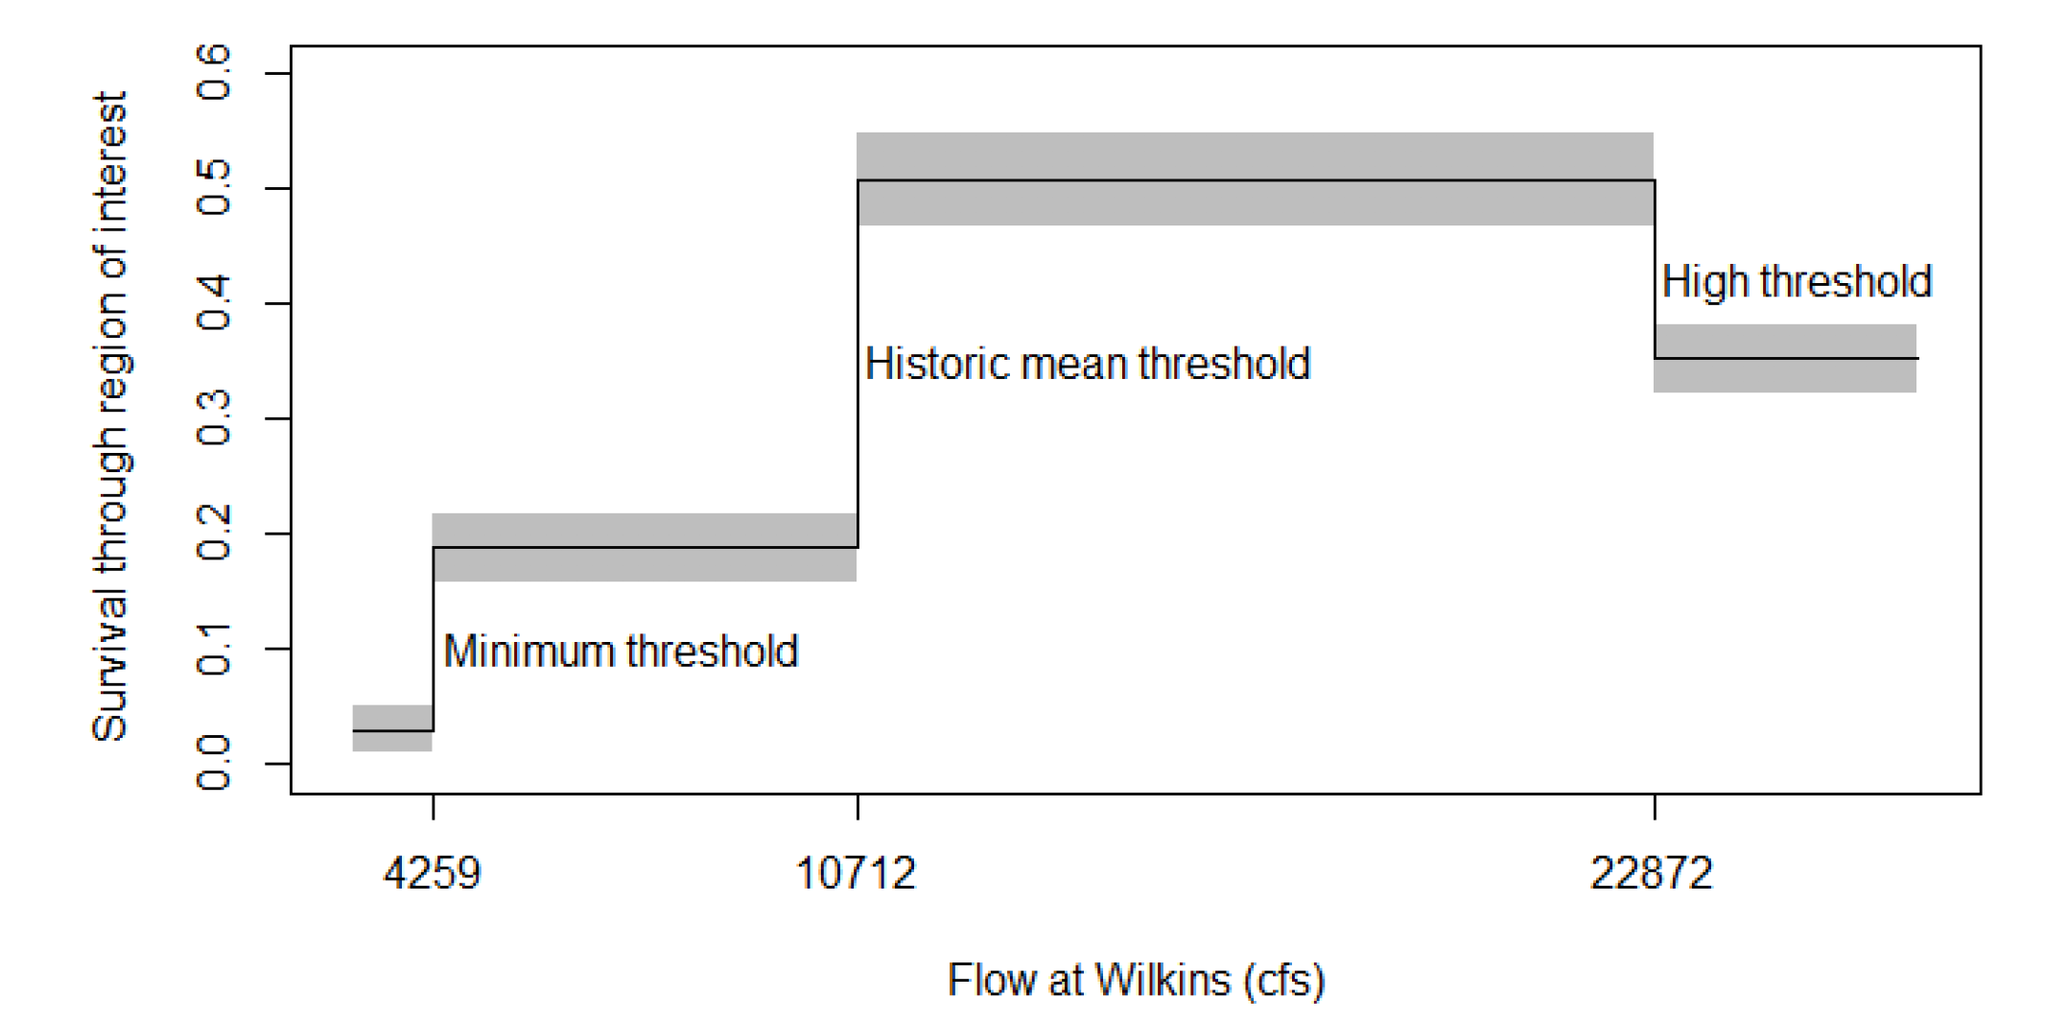
Nonlinear Flow-Survival - Michel et al. (2021)
Notes:
Jim: Figure 6. Thresholds of predicted survival as a function of flow. Predictions are based on the model averaged parameters from the most parsimonious triple threshold models, with mean thresholds at 4,259 cfs, 10,712 cfs, and 22,872 cfs, with 95% confidence intervals (grey fill). Flow averaged from Wilkins Slough gauge through the region of interest (confluence with Deer Creek to confluence with Feather River).

Slide 26
CalSim Average Annual Flow at Wilkins Slough Wet Year v. Dry Year
Notes:
Jim: Base on the progress of investigation we think give the reduced size of the project the upstream location of the diversions, focusing on within year variability by protecting pulse flow events is a better approach to managing survival of emigrating Chinook salmon. We can’t turn a dry year into a wet year with flow standards,

Slide 27
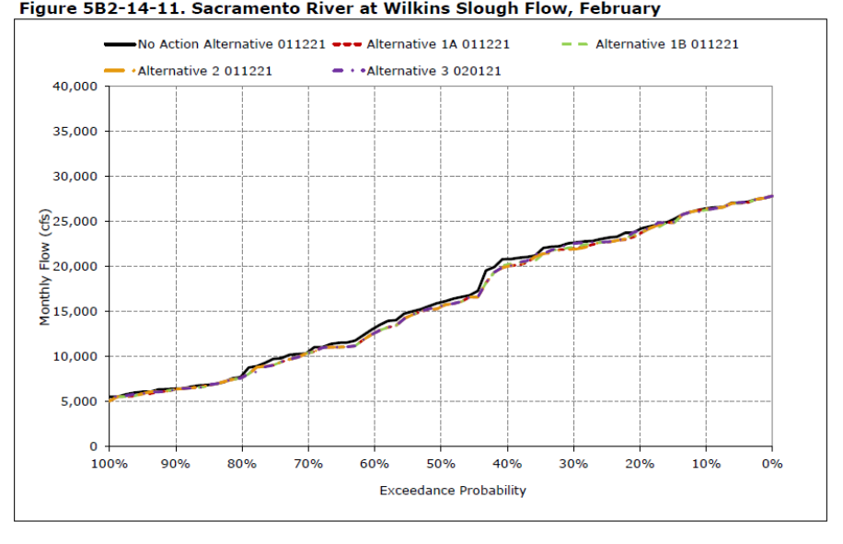
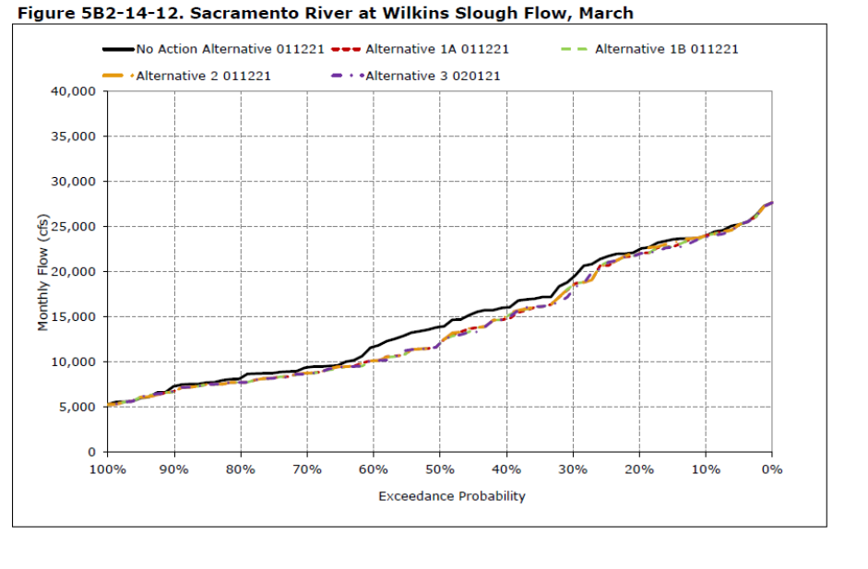
Sacramento River Flow at Wilkins Slough December - March
Notes:
Jim: For the most part CALSIM results deviate little form the NAA. The greatest deviation from the NAA occurs in March in below normal and

